Slide 1

Operating Systems Design​ Session 36: Mutex, Concurrent Linked Lists
19CS2106R​
© 2020 KL University

Slide 2
Synchronisation and Communication
The correct behaviour of a concurrent program depends on synchronisation and communication between its processes
Synchronisation: the satisfaction of constraints on the interleaving of the actions of processes (e.g. an action by one process only occurring after an action by another)
Communication: the passing of information from one process to another
Concepts are linked since communication requires synchronisation, and synchronisation can be considered as contentless communication.
Data communication is usually based upon either shared variables or message passing.
A sequence of statements that must appear to be executed indivisibly is called a critical section
The synchronisation required to protect a critical section is known as mutual exclusion

Slide 3
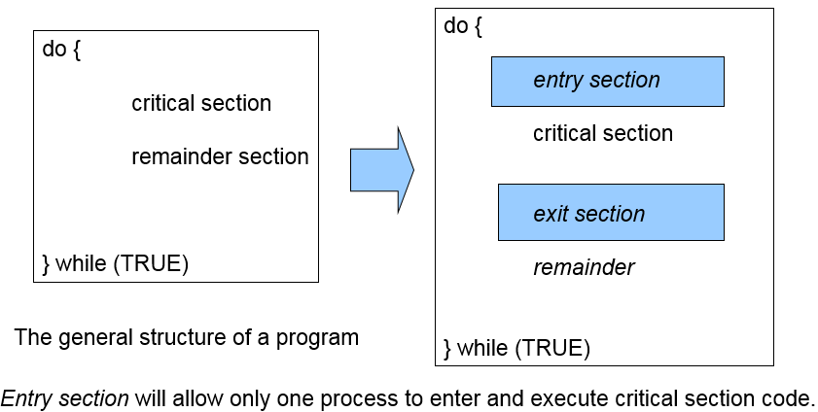
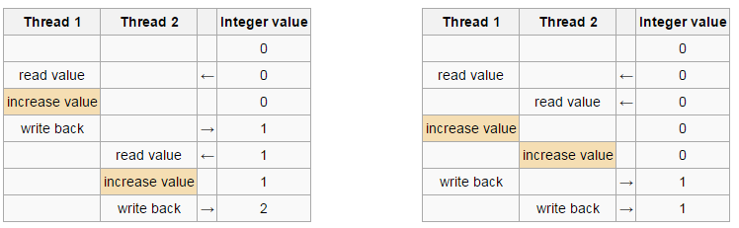
Synchronization
Synchronize threads/coordinate their activities so that when you access the shared data (e.g., global variables) you are not having a trouble.
Multiple processes sharing a file or shared memory segment also require synchronization (= critical section handling).
An example: race condition.
Critical
section:
Critical
section:
critical section respected ☺ not respected ☹

Slide 4
Protecting Accesses to Shared Variables: Mutexes
This program creates two threads, each of which executes the same function. The function executes a loop that repeatedly increments a global variable, glob, by copying glob into the local variable loc, incrementing loc, and copying loc back to glob. (Since loc is an automatic variable allocated on the per-thread stack, each thread has its own copy of this variable.) The number of iterations of the loop is determined by the command-line argument supplied to the program, or by a default value, if no argument is supplied.
When we run the program by specifying that each thread should increment the variable 1000 times, all seems well:
$ ./thread_incr 1000
glob = 2000
However, what has probably happened here is that the first thread completed all of its work and terminated before the second thread even started. When we ask both threads to do a lot more work, we see a rather different result:
$ ./thread_incr 10000000
glob = 16517656
At the end of this sequence, the value of glob should have been 20 million. The problem here results from execution sequences such as the following
4

Slide 5
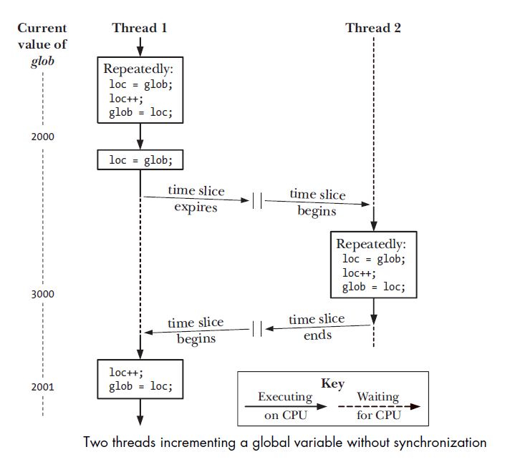
Protecting Accesses to Shared Variables: Mutexes
5

Slide 6
Protecting Accesses to Shared Variables: Mutexes
1. Thread 1 fetches the current value of glob into its local variable loc. Let’s assume that the current value of glob is 2000.
2. The scheduler time slice for thread 1 expires, and thread 2 commences execution.
3. Thread 2 performs multiple loops in which it fetches the current value of glob into its local variable loc, increments loc, and assigns the result to glob. In the first of these loops, the value fetched from glob will be 2000. Let’s suppose that by the time the time slice for thread 2 has expired, glob has been increased to 3000.
4. Thread 1 receives another time slice and resumes execution where it left off. Having previously (step 1) copied the value of glob (2000) into its loc, it now increments loc and assigns the result (2001) to glob. At this point, the effect of the increment operations performed by thread 2 is lost.
If we run the program in Listing 30-1 multiple times with the same command-line argument, we see that the printed value of glob fluctuates wildly:
$ ./thread_incr 10000000
glob = 10880429
$ ./thread_incr 10000000
glob = 13493953
This nondeterministic behavior is a consequence of the vagaries of the kernel’s CPU scheduling decisions. In complex programs, this nondeterministic behavior means that such errors may occur only rarely, be hard to reproduce, and therefore be difficult to find.
6

Slide 7
Protecting Accesses to Shared Variables: Mutexes
To avoid the problems that can occur when threads try to update a shared variable, we must use a mutex (short for mutual exclusion) to ensure that only one thread at a time can access the variable. More generally, mutexes can be used to ensure atomic access to any shared resource, but protecting shared variables is the most common use.
A mutex has two states: locked and unlocked. At any moment, at most one thread may hold the lock on a mutex. Attempting to lock a mutex that is already locked either blocks or fails with an error, depending on the method used to place the lock.
When a thread locks a mutex, it becomes the owner of that mutex. Only the mutex owner can unlock the mutex. This property improves the structure of code that uses mutexes and also allows for some optimizations in the implementation of mutexes. Because of this ownership property, the terms acquire and release are
sometimes used synonymously for lock and unlock.
In general, we employ a different mutex for each shared resource (which may consist of multiple related variables), and each thread employs the following protocol for accessing a resource:
lock the mutex for the shared resource;
access the shared resource; and
unlock the mutex.
7

Slide 8
Protecting Accesses to Shared Variables: Mutexes
Finally, note that mutex locking is advisory, rather than mandatory. By this, we mean that a thread is free to ignore the use of a mutex and simply access the corresponding shared variable(s). In order to safely handle shared variables, all threads must cooperate in their use of a mutex, abiding by the locking rules it enforces.
8

Slide 9
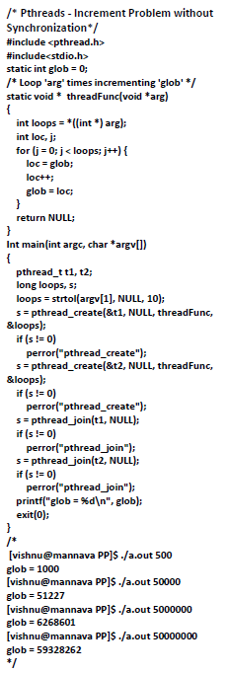
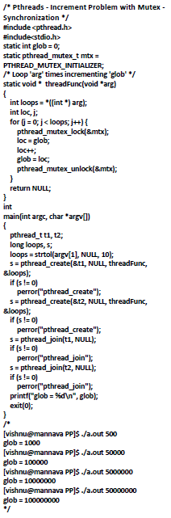
9

Slide 10
Lock-based Concurrent Data structure
Adding locks to a data structure makes the structure thread safe.
A block of code is thread-safe if it can be simultaneously executed by multiple threads without causing problems.
Thread-safeness: in a nutshell, refers an application's ability to execute multiple threads simultaneously without "clobbering" shared data or creating "race" conditions.
For example, suppose that your application creates several threads, each of which makes a call to the same library routine:
This library routine accesses/modifies a global structure or location in memory.
As each thread calls this routine it is possible that they may try to modify this global structure/memory location at the same time.
If the routine does not employ some sort of synchronization constructs to prevent data corruption, then it is not thread-safe.

Slide 11
Lock-based Concurrent Data structure
Solution #1
An obvious solution is to simply lock the list any time that a thread attempts to access it.
A call to each of the three functions can be protected by a mutex.
Solution #2
Instead of locking the entire list, we could try to lock individual nodes.
A “finer-grained” approach.
1 // basic node structure
2 typedef struct __node_t {
3 int key;
4 struct __node_t *next;
5 pthread_mutex_t lock;
6 } node_t;

Slide 12
Concurrent Linked Lists
1 // basic node structure
2 typedef struct __node_t {
3 int key;
4 struct __node_t *next;
5 } node_t;
6
7 // basic list structure (one used per list)
8 typedef struct __list_t {
9 node_t *head;
10 pthread_mutex_t lock;
11 } list_t;
12
13 void List_Init(list_t *L) {
14 L->head = NULL;
15 pthread_mutex_init(&L->lock, NULL);
16 }
17
(Cont.)
12

Slide 13
Concurrent Linked Lists(Cont.)
(Cont.)
18 int List_Insert(list_t *L, int key) {
19 pthread_mutex_lock(&L->lock);
20 node_t *new = malloc(sizeof(node_t));
21 if (new == NULL) {
22 perror("malloc");
23 pthread_mutex_unlock(&L->lock);
24 return -1; // fail
26 new->key = key;
27 new->next = L->head;
28 L->head = new;
29 pthread_mutex_unlock(&L->lock);
30 return 0; // success
31 }
(Cont.)
13

Slide 14
Concurrent Linked Lists(Cont.)
(Cont.)
32
32 int List_Lookup(list_t *L, int key) {
33 pthread_mutex_lock(&L->lock);
34 node_t *curr = L->head;
35 while (curr) {
36 if (curr->key == key) {
37 pthread_mutex_unlock(&L->lock);
38 return 0; // success
39 }
40 curr = curr->next;
41 }
42 pthread_mutex_unlock(&L->lock);
43 return -1; // failure
44 }
14

Slide 15
Concurrent Linked Lists(Cont.)
The code acquires a lock in the insert routine upon entry.
The code releases the lock upon exit.
If malloc() happens to fail, the code must also release the lock before failing the insert.
This kind of exceptional control flow has been shown to be quite error prone.
Solution: The lock and release only surround the actual critical section in the insert code
15

Slide 16
Concurrent Linked List: Rewritten
1 void List_Init(list_t *L) {
2 L->head = NULL;
3 pthread_mutex_init(&L->lock, NULL);
4 }
5
6 void List_Insert(list_t *L, int key) {
7 // synchronization not needed
8 node_t *new = malloc(sizeof(node_t));
9 if (new == NULL) {
10 perror("malloc");
11 return;
12 }
13 new->key = key;
14
15 // just lock critical section
16 pthread_mutex_lock(&L->lock);
17 new->next = L->head;
18 L->head = new;
19 pthread_mutex_unlock(&L->lock);
20 }
21
16

Slide 17
Concurrent Linked List: Rewritten(Cont.)
(Cont.)
22 int List_Lookup(list_t *L, int key) {
23 int rv = -1;
24 pthread_mutex_lock(&L->lock);
25 node_t *curr = L->head;
26 while (curr) {
27 if (curr->key == key) {
28 rv = 0;
29 break;
30 }
31 curr = curr->next;
32 }
33 pthread_mutex_unlock(&L->lock);
34 return rv; // now both success and failure
35 }
17

Slide 18
Scaling Linked List
Hand-over-hand locking (lock coupling)
Add a lock per node of the list instead of having a single lock for the entire list.
When traversing the list,
First grabs the next node’s lock.
And then releases the current node’s lock.
Enable a high degree of concurrency in list operations.
However, in practice, the overheads of acquiring and releasing locks for each node of a list traversal is prohibitive.
18

Slide 19
Pthreads Read-Write Locks
Neither of our multi-threaded linked lists exploits the potential for simultaneous access to any node by threads that are executing Member.
The first solution only allows one thread to access the entire list at any instant
The second only allows one thread to access any given node at any instant.
A read-write lock is somewhat like a mutex except that it provides two lock functions.
The first lock function locks the read-write lock for reading, while the second locks it for writing.
19

Slide 20
Pthreads Read-Write Locks
So multiple threads can simultaneously obtain the lock by calling the read-lock function, while only one thread can obtain the lock by calling the write-lock function.
Thus, if any threads own the lock for reading, any threads that want to obtain the lock for writing will block in the call to the write-lock function.
If any thread owns the lock for writing, any threads that want to obtain the lock for reading or writing will block in their respective locking functions.
20

Slide 21
Pthreads Read-Write Locks
Readerwriter locks are similar to mutexes, except that they allow for higher degrees of parallelism. With a mutex, the state is either locked or unlocked, and only one thread can lock it at a time. Three states are possible with a readerwriter lock: locked in read mode, locked in write mode, and unlocked. Only one thread at a time can hold a readerwriter lock in write mode, but multiple threads can hold a readerwriter lock in read mode at the same time.
When a readerwriter lock is write-locked, all threads attempting to lock it block until it is unlocked. When a readerwriter lock is read-locked, all threads attempting to lock it in read mode are given access, but any threads attempting to lock it in write mode block until all the threads have relinquished their read locks. Although implementations vary, readerwriter locks usually block additional readers if a lock is already held in read mode and a thread is blocked trying to acquire the lock in write mode. This prevents a constant stream of readers from starving waiting writers.
21

Slide 22
Pthreads Read-Write Locks
Readerwriter locks are well suited for situations in which data structures are read more often than they are modified. When a readerwriter lock is held in write mode, the data structure it protects can be modified safely, since only one thread at a time can hold the lock in write mode. When the readerwriter lock is held in read mode, the data structure it protects can be read by multiple threads, as long as the threads first acquire the lock in read mode.
Readerwriter locks are also called sharedexclusive locks. When a readerwriter lock is read-locked, it is said to be locked in shared mode. When it is write-locked, it is said to be locked in exclusive mode.
As with mutexes, readerwriter locks must be initialized before use and destroyed before freeing their underlying memory.
22

Slide 23
Pthreads Read-Write Locks
#include <pthread.h>
int pthread_rwlock_init(pthread_rwlock_t *restrict rwlock, const pthread_rwlockattr_t *restrict attr);
int pthread_rwlock_destroy(pthread_rwlock_t *rwlock);
Both return: 0 if OK, error number on failure
#include <pthread.h>
int pthread_rwlock_rdlock(pthread_rwlock_t *rwlock);
int pthread_rwlock_wrlock(pthread_rwlock_t *rwlock);
int pthread_rwlock_unlock(pthread_rwlock_t *rwlock);
All return: 0 if OK, error number on failure
23

Slide 24
Thank you

